Slide 1
DATA VISUALIZATION
11/4/2022

Slide 2
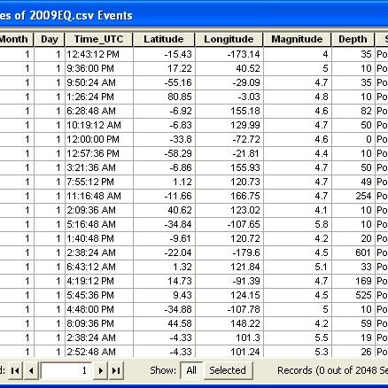
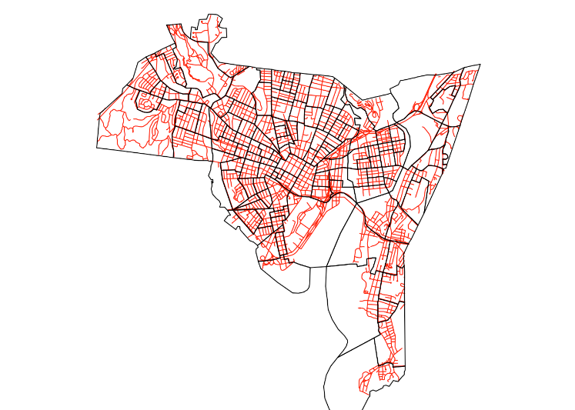
Visualizing Spatial Data
Large spatial data sets can be seen as a result of accumulating samples or readings of phenomena in the real world, while moving along two dimensions in space. Often, spatial data sets are discrete samples of a continuous phenomenon.
A common example of spatial data can be seen in a road map. A road map is a two-dimensional object that contains points, lines, and polygons that can represent cities, roads, and political boundaries such as states or provinces.

Slide 3
Phenomenon’s of Spatial Data
1. Point Phenomena
2. Line Phenomena
3. Area Phenomena
4. Surface Phenomena

Slide 4
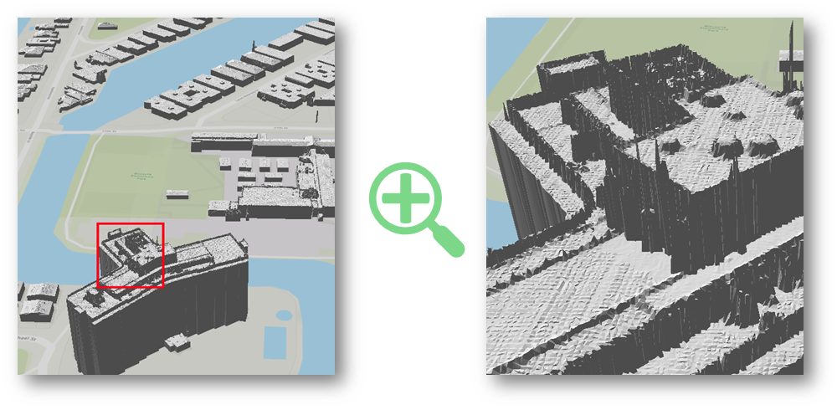
Point Phenomena
Have no spatial extent; they can be termed zero dimensional and can be specified by a longitude and latitude coordinate pair, along with a set of descriptors or attributes.
Examples are buildings, oil wells, aggregated measures, and cities.

Slide 5
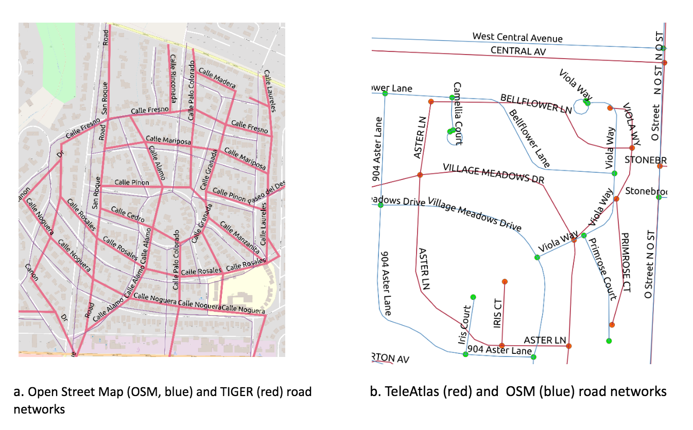
Line phenomena
Have length, but essentially no width; they can be termed one-dimensional and can be specified by an unclosed series of longitude and latitude coordinate pairs for each phenomenon.
Examples are large telecommunication networks, roads, and boundaries between countries. Attributes associated with line phenomena might include capacities, traffic levels, and names

Slide 6
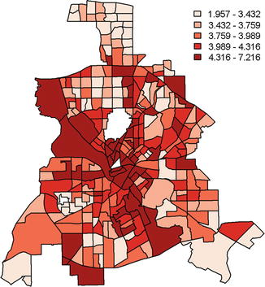
Area phenomena
Have both length and width; they can be termed two-dimensional and can be specified by a series of longitude and latitude coordinate pairs that completely enclose a region, along with a set of attributes for each phenomenon.
Examples are lakes, and political units such as states or counties

Slide 7
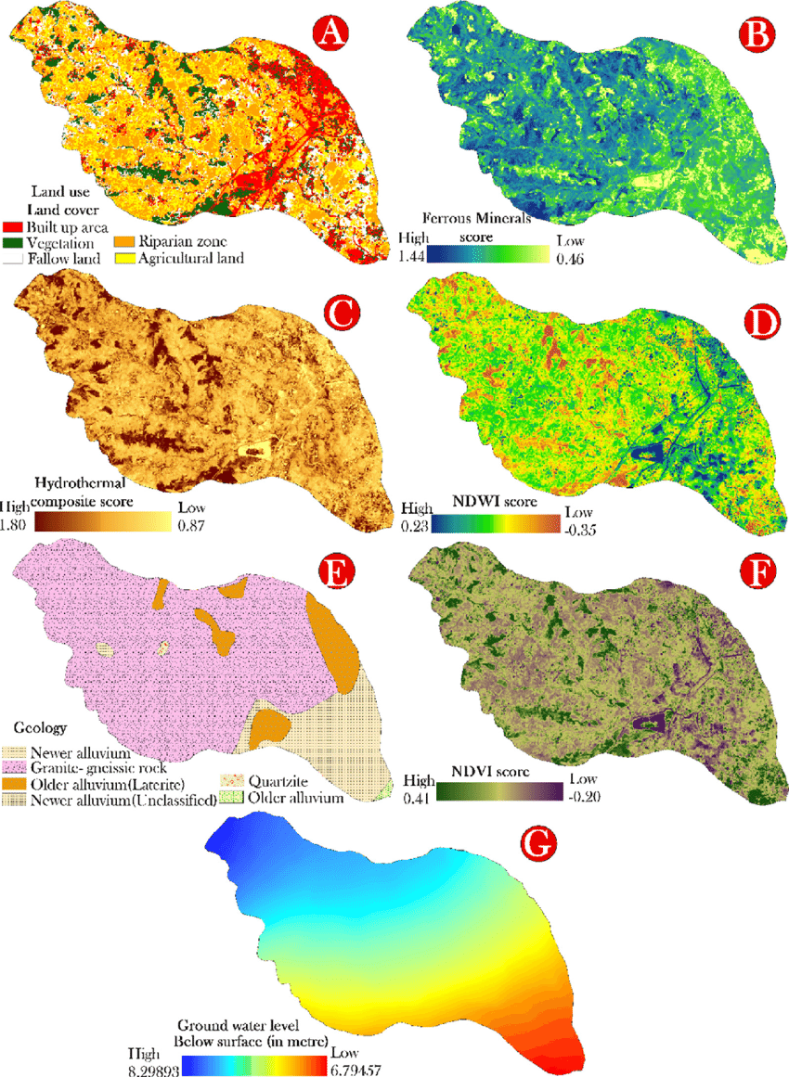
SURFACE PHENOMENA
Have length, width and height; they are termed two-and-half-dimensional and can be specified by a series of longitude latitude, and height coordinate vectors with a set of attributes for each (longitude, latitude) pair.

Slide 8
Types of Maps
Maps can be subdivided into map types based on properties of the data (qualitative versus quantitative; discrete versus continuous) and the properties of the graphical variables (points, lines, surface, volumes). Examples of the resulting maps are
• symbol maps (nominal point data);
• dot maps (ordinal point data);
• land use maps (nominal area data);
• choropleth maps (ordinal area data);
• line diagrams (nominal or ordinal line data);
• isoline maps (ordinal surface data);
• surface maps (ordinal volume data).

Slide 9
Projections
In visualizing geospatial data, map projections play a critical role. Map projections are concerned with mapping the positions on the globe (sphere) to positions on the screen (flat surface)
A map projection is defined as Π:(λ, ϕ) → (x, y).
The data format for degrees of longitude (λ) is fixed to the interval [-180, 180], where negative values stand for western degrees and positive values for eastern degrees.
The degrees of latitude (ϕ) are defined similarly on the interval [-90, 90],where negative values are used for southern degrees and positive values for northern degrees.
ϕ measured degrees of latitude in radians
λ measured degrees of longitude in radians
x horizontal axis of the two-dimensional map
y vertical axis of the two-dimensional map

Slide 10
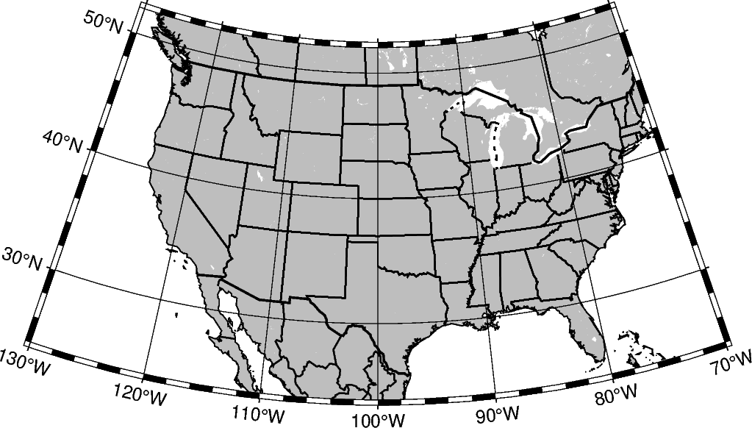
PROJECTIONS
A conformal projection retains the local angles on each point of a map correctly, which means that they also locally preserve shapes. The area, however, is not preserved.

Slide 11
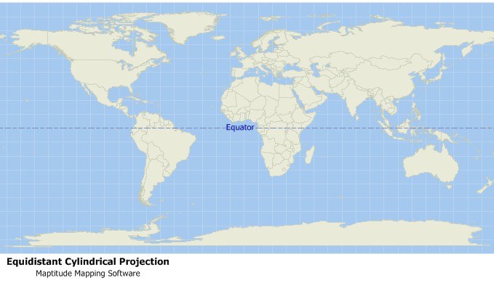
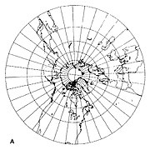
• A projection is called equidistant if it preserves the distance from some standard point or line.
• Gnomonic projections allow all great circles to be displayed as straight lines. Great circles are the largest circle that can be drawn on a given sphere and cut the sphere into two halves of equal size. Gnomic projections preserve the shortest route between two points
• A map projection is called equivalent or equal area if a specific area on one part of the map covers exactly the same surface on the globe, as another part of the map. Area-accurate projections result in a distortion of form and angles.

Slide 12
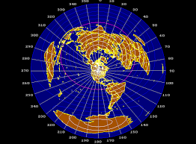
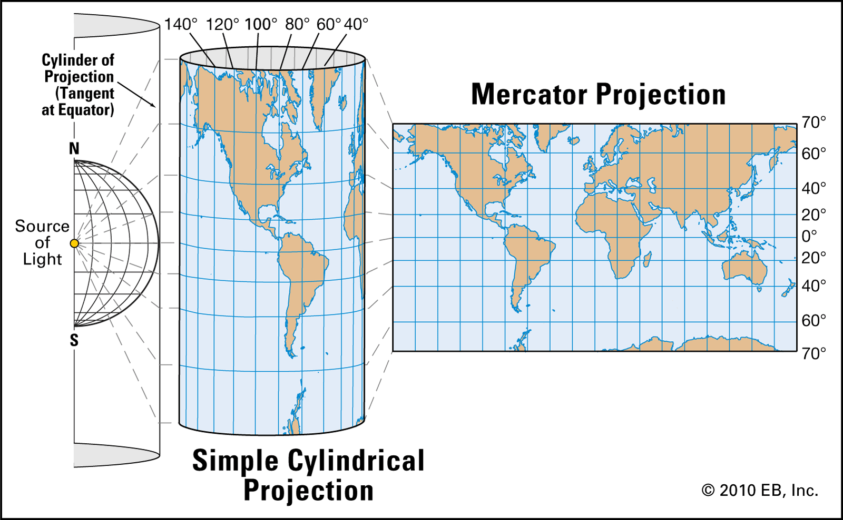
Contd.
Azimuthal projections preserve the direction from a central point. Usually these projections also have radial symmetry in the scales, e.g., distances from the central point are independent of the angle and consequently, circles with the central point as centre result in circles that have the central point on the map as their centre
Cylinder projections project the surface of the sphere on a cylinder that is put around the sphere. Each point of the sphere is projected outward on the cylinder. Cylinder projections allow the entire spherical surface to be visible. Most cylinder projections preserve local angles and are therefore conformal projections. The degrees of longitude and latitude are usually orthogonal to each other. Pseudo-cylindrical projections represent the central meridian and each parallel as a single straight line segment, but not the other meridians.

Slide 13
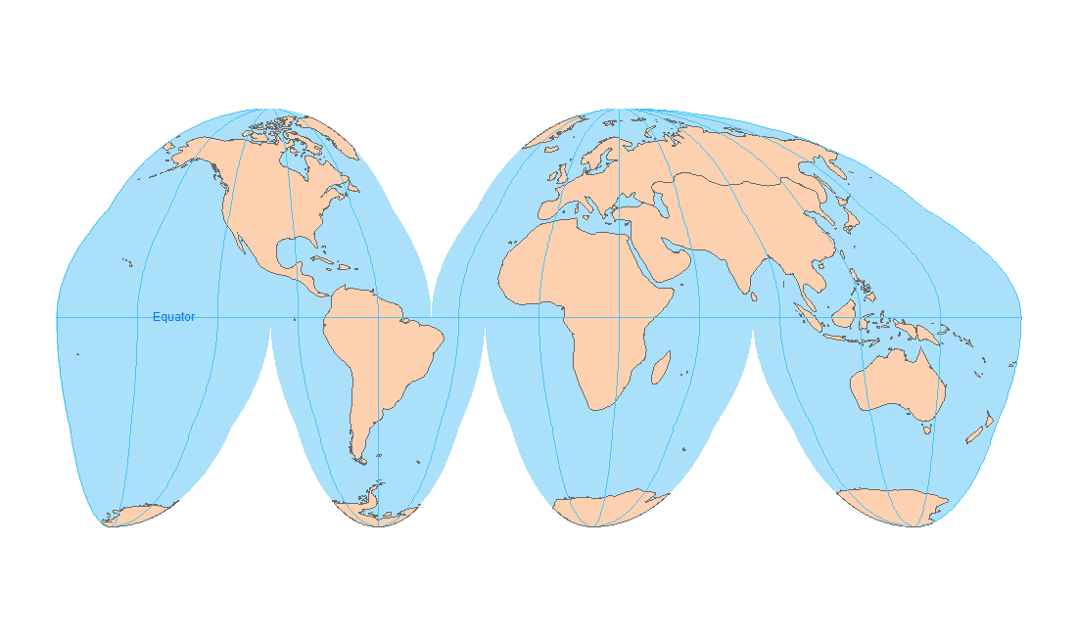
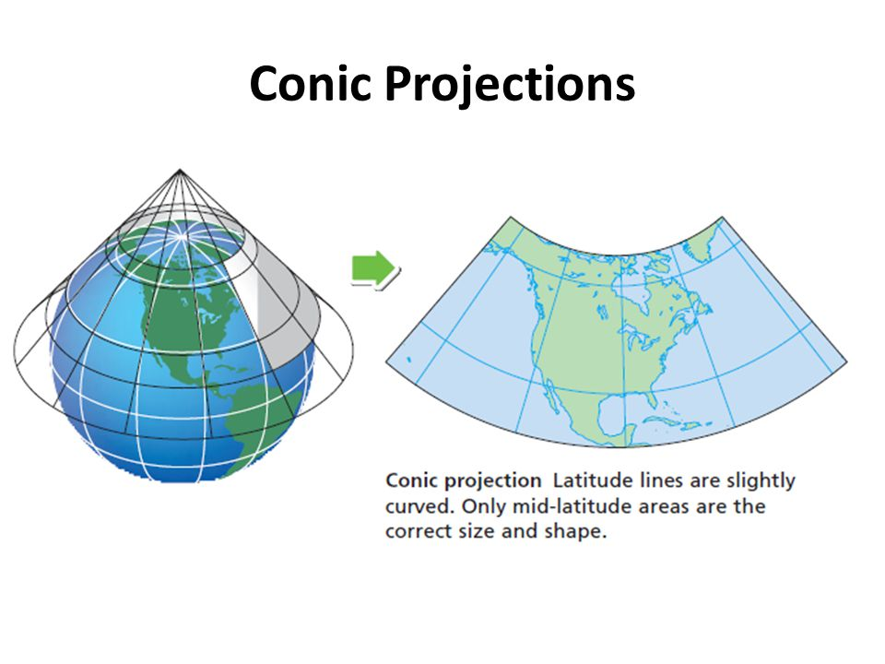
Contd.
Plane projections are azimuthal projections that map the surface of the sphere to a plane that is tangent to the sphere, with the tangent point corresponding to the centre point of the projection. Some plane projections are true perspective projections.
Cone projections map the surface of the sphere to a cone that is tangent to the sphere. Degrees of latitude are represented as circles around the projection centre, degrees of longitude as straight lines outgoing from this centre. Cone projections may be designed in a way that preserves the distance from the centre of the cone. There are also a number of pseudo-conical projections that, for example, retain the distances from the pole, as well as the distances from the meridian.

